Slide 1
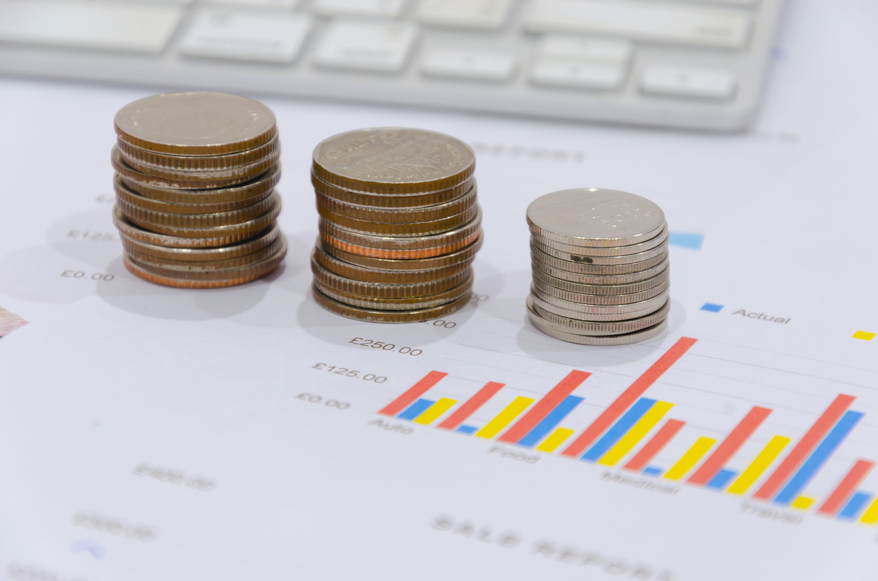

Nowcasting GDP in Egypt
A CASE STUDY UTILIZING ALTERNATIVE DATA IN NOWCASTING GDP
Presented by: Ali ElGamal

Slide 2
Understanding the Context
Economic Background:
GDP is a crucial measure for assessing economic health and informing policy decisions.
Accurate GDP forecasting faces challenges such as data lags and unforeseen economic events.
The Role of Alternative Data:
Leveraging unconventional data sources provides real-time insights into economic activities and improves forecasting accuracy.

Slide 3

Potential Alternative Data Sources
Google Trends:
Offers insights into real-time economic activity through monitoring specific search terms.
Demonstrated predictive power over various economic indicators
Mobility Indicators:
Data from platforms like Google Mobility provide insights into economic activities.
Tracks movement into key locations such as workplaces, retail spaces, and recreational sites which indicates consumer behavior.

Slide 4
Continued Data Sources
Air Quality Indices:
Recent analyses show air quality as a proxy for economic conditions.
Varies with the intensity of industrial activity, serving as an indirect measure of economic well-being.
Surveys and Sentiment Indicators:
Regularly conducted business surveys and consumer sentiment indicators reflect economic expectations and confidence levels, crucial for understanding future GDP performance.
High-Frequency Indicators:
Leading indicators, such as industrial production and consumer surveys, provide timely insights into GDP growth.
Particularly useful in periods of economic volatility and uncertainty.

Slide 5

Case Studies from Other Countries
New Zealand | Turkey | Lebanon | Latin America
Machine-learning techniques applied to diverse datasets improved GDP growth forecasts, showcasing the importance of data diversity. | Combined economic indicators with machine learning to reduce forecast errors, demonstrating enhanced accuracy with ensemble models. | Utilized Google Trends and high-frequency indicators for effective GDP nowcasting, proving flexibility in challenging economic situations. | Combined mobility indicators with Google search data to study economic consequences during the COVID-19 pandemic.

Slide 6
Methodology for Ranking Alternative Data Sources
Definition of Ranking Criteria:
Establish criteria for evaluating and ranking each data source:
Relevance
Timeliness
Availability
Quality
Predictive Power
Cost
Weighting the Criteria:
Assign weights based on significance for GDP nowcasting:
Relevance: 30%
Timeliness: 25%
Availability: 20%
Quality: 15%
Predictive Power: 10%
Scoring Each Data Source:
Evaluate each source using a scoring scale (1 to 5, with 1 being poor and 5 being excellent).

Slide 7
Ranking Process
Data Types | Data Source Relevance (30%) | Timeliness (25%) | Availability (20%) | Quality (15%) | Predictive Power (10%) | Total Score
Google Trends | 5 (1.5) | 4 (1.0) | 5 (1.0) | 4 (0.6) | 5 (0.5 | 4.6
Air Quality | 4 (1.2) | 3 (0.75) | 4 (0.8) | 4 (0.6) | 3 (0.3) | 4.15
High-Frequency Indicators | 5 (1.5) | 5 (1.25 | 4 (0.8) | 5 (0.75) | 4 (0.4) | 4.7
Notes:
Calculating Weighted Scores:
Total Score = ∑(Scoreᵢ × Weightᵢ)
Ranking the Data Sources:
Rank the sources from highest to lowest based on total scores.

Slide 8
Conclusion of Part A
Key Takeaways from Part A:
Identified and evaluated multiple alternative data sources relevant to GDP nowcasting.
Ranked sources based on criteria such as relevance, timeliness, availability, and predictive power.
Top-Ranked Sources: High-Frequency Indicators, Google Trends, and Air Quality data.

Slide 9
Transition to Part B – Modeling Approach
From Data to Insights: Building the Nowcasting Model
we now turn to Part B: Modeling.
This section details:
The modeling approach to derive nowcasts of Egypt's GDP.
Methodologies and techniques applied to achieve predictive accuracy.
Enhancements with Google Trends data to refine GDP nowcasting.

Slide 10
Overview and Objectives
Significance of the Study:
Leveraging high-frequency data sources can improve forecasting accuracy and responsiveness to economic shifts.
Methodology Summary:
Utilize Google Trends keywords, select relevant data features, and build a predictive model to nowcast monthly GDP.
Deliverables:
Presentation, detailed report, Python notebook, and Excel sheets containing processed data and results.
Project Objective:
To develop a nowcasting model for GDP in Egypt using alternative data sources like Google Trends.
Problem Statement:
Traditional GDP reporting often has significant time lags. Nowcasting allows for more timely and frequent insights into economic performance.

Slide 11


Data Sources and Feature Selection Process
Primary Data Sources:
Google Trends: Keyword searches relevant to economic indicators, such as 'gold prices today,' 'car market'.
Monthly GDP Data: Provided historical GDP figures for Egypt, serving as the model’s target variable.
Feature Selection Criteria:
Correlation with GDP: Identified keywords and categories that showed a high correlation with GDP fluctuations.
Relevance to Economic Activity: “Selected terms that reflect consumer and market trends to improve model responsiveness.
Feature Reduction:
Multicollinearity Assessment: Calculated Variance Inflation Factor (VIF) to drop highly correlated features and avoid redundancy.
Final Feature Set: Refined dataset to include only the most predictive features for GDP nowcasting.

Slide 12



Data Sources and Feature Selection Process
Primary Data Sources
Feature Selection Criteria
Feature Reduction
Google Trends
Monthly GDP Data
Multicollinearity Assessment
Refined dataset
Correlation with GDP
Relevance to using Economic Activity

Slide 13

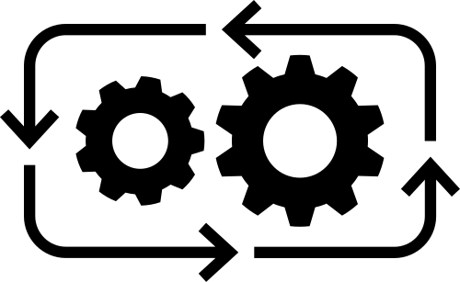

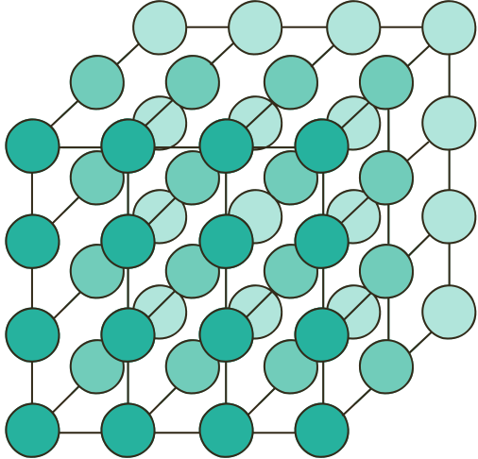
Methodology and Model Development
Data Preprocessing
Modeling Approach
Model Training and Validation
Scaling and Standardization:
Ensured features are on a comparable scale to improve model accuracy
Handling Missing Data
Nowcasting Model Selection :experimented with Linear Regression, Elastic Net and SVM
Feature Selection Strategy
Train-Test split : used a 80-20 split
Evaluation Metrics:
Used Mean Squared Error, R², and Mean Absolute Percentage Error to assess model performance

Slide 14
Methodology and Model Development
Performance metrics:
Linear Regression | Elastic Net | SVM | Random Forrest
MSE: [248] R²: [0.88] | MSE: [225.10] R²: [0.8925] | MSE: [222.47] R²: [0.8935] | MSE: [289.32] R²: [0.86]
Insights from Evaluation:
The SVM model achieved the highest R² score and the lowest MAPE, indicating better predictive accuracy for GDP nowcasting.
Best Model Selection:
The SVM model was chosen for its superior accuracy and better handling of complex relationships in the data.

Slide 15
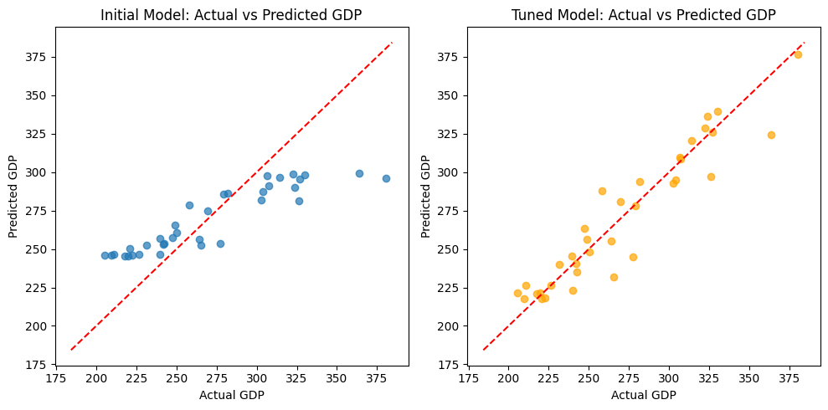

Before and After : Hyperparameter Tuning- SVM
Initial Model:
Mean Squared Error (MSE): 819.81
R² Score: 0.61
Tuned Model:
Mean Squared Error (MSE): 222.47
R² Score: 0.89
Improvement: Hyperparameter tuning significantly improved model performance, decreasing the MSE by over 70% and boosting the R² score by 0.28, indicating a better fit.

Slide 16
Summary of Research Insights
Importance of Timely GDP Forecasting:
Urgent need for accurate and timely GDP forecasting due to rapid economic changes.
Traditional methods rely on delayed data, lacking real-time insights.
Alternative Data Sources:
Utilization of innovative data sources (Google Trends, mobility indicators, air quality indices) to enhance GDP nowcasting for Egypt.
Each data source offers unique insights into economic activity and conditions.
Research Contributions:
A systematic approach to evaluating and ranking alternative data sources can improve the understanding of economic dynamics.
Methodology focuses on relevance, timeliness, quality, and predictive power to identify the most effective data sources.
Future Implications:
Continuous refinement of nowcasting models is essential for adapting to changing economic conditions.

Slide 17
Conclusion
Key Insights:
This project successfully demonstrated the viability of using alternative data sources such as Google Trends for GDP nowcasting in Egypt.
The integration of search interest keywords related to economic activities, particularly "أسعار الذهب اليوم" and "سوق السيارات" , revealed significant correlations with GDP fluctuations.
Methodology Strengths:
Comprehensive data collection from reliable sources (Central Bank of Egypt )
Rigorous data preparation ensured quality inputs for model development, utilizing techniques like interpolation for missing values and Min-Max scaling for normalization.

Slide 18
Conclusion
Model Development:
A variety of modeling techniques were employed, including Linear Regression, Support Vector Machine (SVM), Random Forest, and Elastic Net.
Hyperparameter tuning via GridSearchCV optimized model performance, with the SVM model achieving the best results
Results & Visualization:
Actual vs. predicted GDP plots illustrated the effectiveness of the models, confirming the potential of Google Trends as a leading indicator for economic activity.
The consistent performance across multiple modeling techniques underscored the robustness of the findings, providing a solid foundation for future research and applications.

Slide 19
Future Work
The insights gained from this study highlight the importance of incorporating alternative data sources in economic forecasting.
Continuous exploration of new data avenues and advanced modeling techniques can further enhance the accuracy and reliability of GDP predictions.

Slide 20

Q&A Time
Do you have any questions ?

Slide 21
Thank you

